Slide 1
Creativity & Innovation
BM006-3-2-CRI (VC1) 1st April 2018
Lecture 2:
Theories of innovation

Slide 2
Topic Learning Outcomes
To demonstrate critical understanding of the well-established concepts in:
  Theories of innovation
  The macro perspectives
  Technological change
  Technological paradigms
  The micro perspective

Slide 3

Diffusion of Innovations
Everett Rogers—the main developer
  Adapted ideas from Gabriel Tarde and from the Hybrid Seed Corn Study (Ryan & Gross)
This theory has been used and studied across many fields: Rural sociology, Medical sociology, Anthropology, Economics, Marketing

Slide 4
Innovation
Innovation = An idea, practice, or object perceived as new by an individual or other unit of adoption
  Software (necessary)
  Hardware (optional)
The Diffusion of Innovations Theory attempts to predict adoption of innovations. . . Typically, the adoption follows a standard pattern:

Slide 5
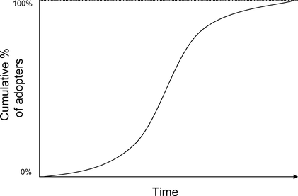
The Classic S-Shaped Adoption Curve

Slide 6
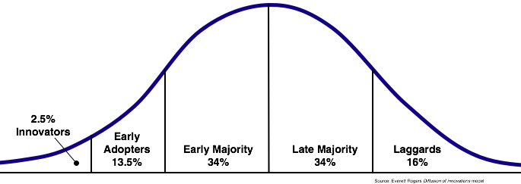
The corresponding Classic Bell-Shaped Adopters Curve

Slide 7
The corresponding Classic Bell-Shaped Adopters Curve
Many studies have looked at how these groups differ:
Innovators are highly cosmopolite and open to new things.
Early adopters tend to be opinion leaders.
Early majority provide “legitimization” of the innovation.
Late majority are skeptical.
Laggards put trust in the status quo.

Slide 8
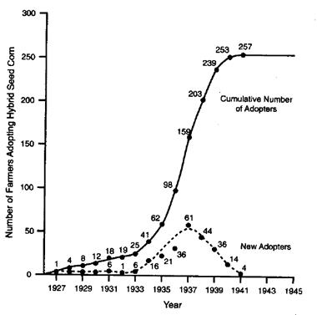
Examples showing how the 2 curves relate

Slide 9
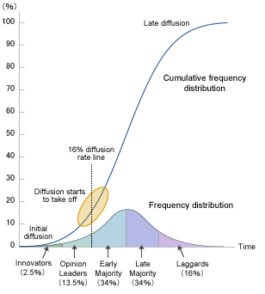

Slide 10
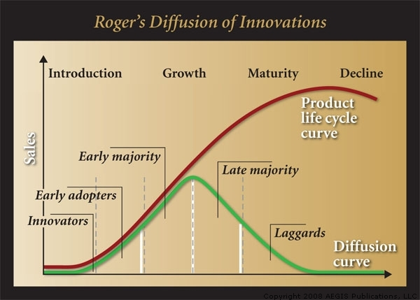

Slide 11
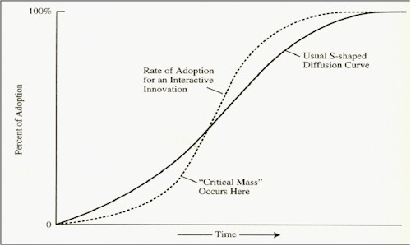
Rate of adoption for an Interactive Innovation (what is an Interactive Innovation?). . . Note “critical mass”

Slide 12
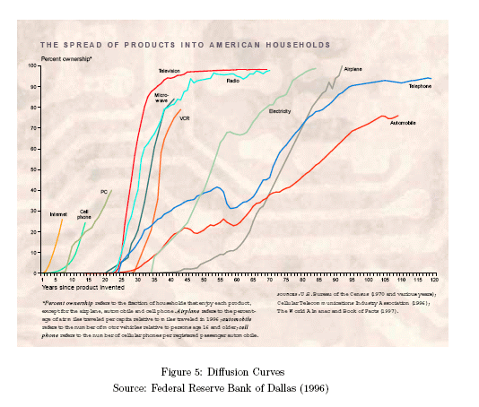

Slide 13
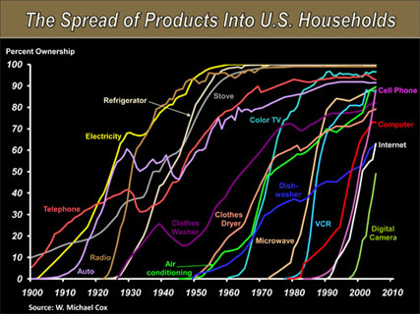
Source: AOL News, 2010

Slide 14
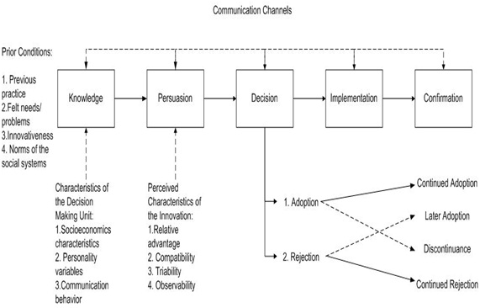
The Innovation-Decision Process of the Individual (person or other unit)

Slide 15
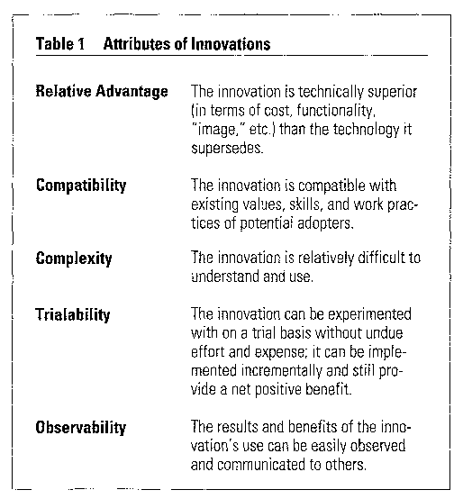
Attributes of Innovations that Impact on Rate of Adoption

Slide 16
Example
Home Video
  Betamax → VHS → Laser → DVD → Blue-ray

Slide 17
Individual Differences and Adoption
Rogers originally identified key social indicators (demographics) as related to innovativeness:
  SES (socio-economic status)
  Education
Atkin, Neuendorf, & Jeffres (1998; 2003), studying adoption of audio information services and digital TV, identified a trend:
  Attitudinal and communication variables more important than demographics
  WHY???
  Hardware vs. software??

Slide 18
Individual Differences and Adoption
Blake et al. (2004 – 2009) identified national or cultural differences in factors that seem to affect adoption of online shopping; e.g.:
  In Poland, “perceived newness” is a positive factor
  In Greece, online shopping is seen as highly compatible with past practices (catalog shopping)

Slide 19
The Role of Opinion Leaders
Opinion Leadership was first identified by Lazarsfeld, Berelson, and Gaudet in their 1944 book The People’s Choice (see also textbook)
  Reported on first (1940) in a series of studies of voters in Erie County, Ohio (why Erie County??)
  Unexpectedly found a Two-Step Flow of communication about the presidential race. . .
    Mass Media → Opinion Leaders → Opinion Followers
  A combination of media and interpersonal channels resulted in information and influence re the election

Slide 20
More on Opinion Leaders
Opinion leadership is the degree to which an individual is able to influence others’ attitudes or behaviors informally
Opinion leaders exist at “all levels” (textbook)
Opinion leaders may be monomorphic or polymorphic
Opinion leaders tend to:
  Be more exposed to all forms of communication (media and interpersonal)
  Have higher SES (socio-economic status)
  Be more innovative

Slide 21
The Role of Change Agents
A change agent is an individual who influences clients’ innovation-decisions in a direction deemed desirable by a change agency
Change agents are more successful if they:
  Have homophily with the targeted “clients”
  Have credibility with the targeted “clients”
  Use opinion leaders to reach others

Slide 22
Consequences of Innovations
Desirable vs. Undesirable
Anticipated vs. Unanticipated
Examples of Undesirable, Unanticipated Consequences:
  Clipper ships and the Irish Potato Famine
  The Learning Gap (e.g., Sesame Street)
  . . . And the Knowledge Gap (Jeffres et al., 2003)
  . . . And The Digital Divide
  Birth control (Idiocracy video)

Slide 23

Idiocracy
2006 satiric science fiction film, directed and
co-produced, co-written by Mike Judge (Beavis
and Butt-Head, Office Space)
Controversy over its “release” (a true case study in Gatekeeping!!)
  No trailers or ads were released, and only 2 still photos
  Theatrically released by 20th-Century Fox to fulfill contractual obligations to the producers—in only 7 cities, at 130 theaters
  Speculation and criticism in the media noted that Fox may have wanted to “bury” the film due to:
    its cautionary tale about low-intelligence dysgenics
    its anti-corporate message
  Its eventual 2007 release to DVD made it a cult favorite

Slide 24
Question and answer session
Q & A
Slide <<number>> of 13

Slide 25
What we will cover next
Problem solving
Slide <<number>> of 13

Slide 26
Activities
Select one company from the charts, analyse the background and the innovative business activities of the company.
https://www.technologyreview.com/lists/companies/2016/

